Slide 1
ASP.NET MVC
Lesson 2 Entity Framework

Slide 2
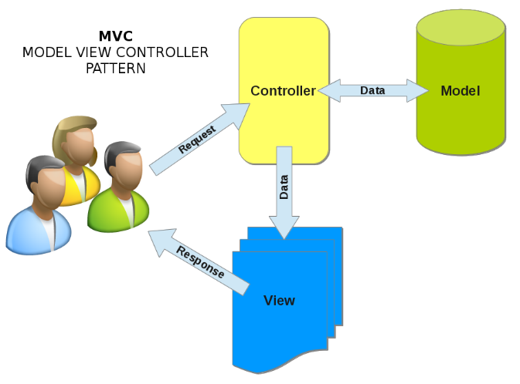
Entity Framework
Code First
Creating the Model Classes
Creating the DatabaseContext Class
Generating the Database Tables
Seeding the database
SQL Server Object Explorer

Slide 3
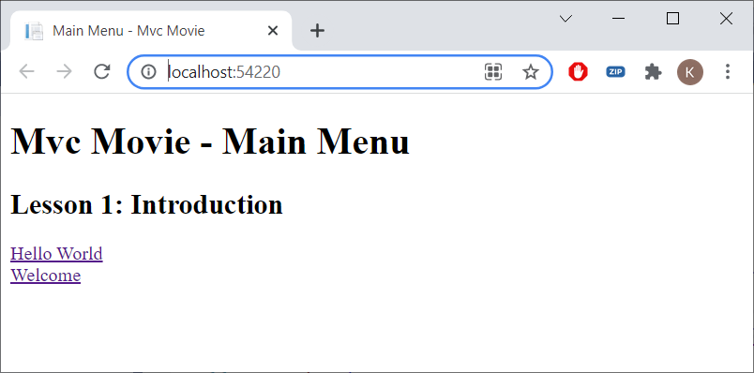
Open MvcMovie.sln

Slide 4
Entity framework
Object/Relational Mapping (ORM) framework
RDBMS (SQL Server) ⬄ OO (C#)
SQL ⬄ Methods (SQL generated automatically)
Database tables ⬄ DBSets (~ collections)
Rows ⬄ Objects
Colums ⬄ Properties
Joins ⬄ Navigation properties
Publisher.Books[1].Author.Name
Publisher
Book
Author

Slide 5
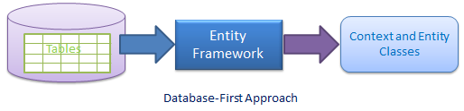
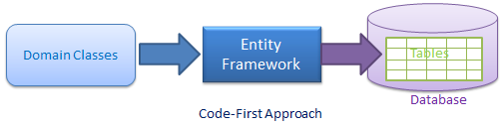
Entity Framework
EF Code First
The database is created from the models

Slide 6
Data Model
Movie
MovieID
Title
ReleaseDate
Genre
Price
RatingID
Navigation property
Rating
Rating
RatingID
Code
Name
Navigation property
Movies

Slide 7
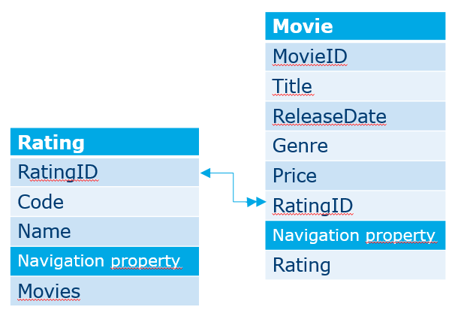
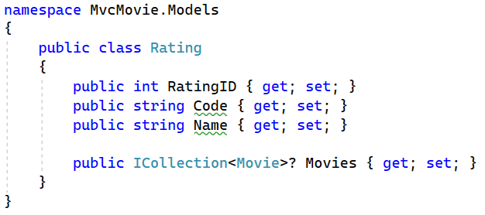
Creating the model
Models | Add | Class | Rating.cs
Both RatingID and ID are recognized by EF as primary key
Movies is a navigation property (cfr. FK in Movie)

Slide 8
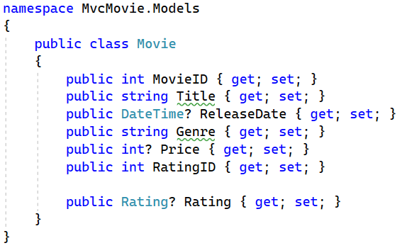
Movie.cs
? = nullable, otherwise no nulls allowed
Rating is a navigation property

Slide 9
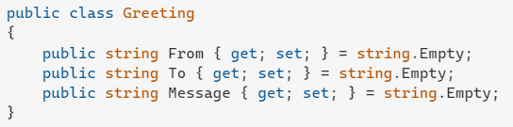
Warnings
The compiler is warning us that the default assignment of our string property (which is null) doesn't match its stated type (which is non-null string).
We could give the properties defaults in-line (empty string)

Slide 10
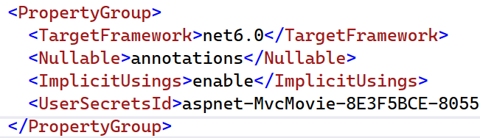

Warnings
MvcMovie | Edit project File |

Slide 11
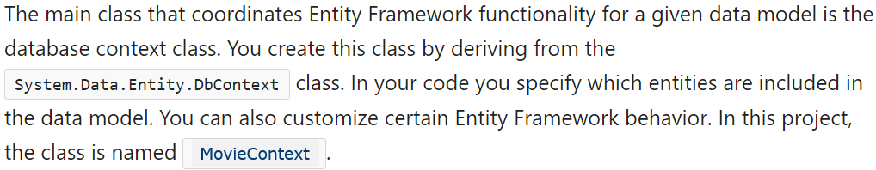
Database COntext
Data | Add | Class | MovieContext.cs
All communication/functionalities (create, read, update, delete) with the DB goes via the DBContext class

Slide 12
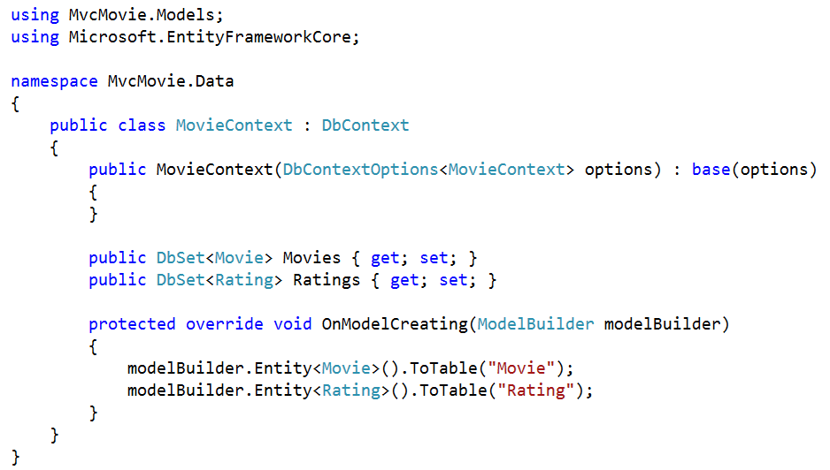
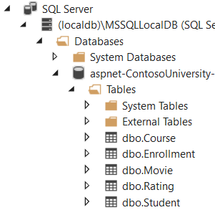
MovieContext.cs (resources or code-site)

Slide 13
Entity Framework
Database
MovieContext
Movies
Movie
Select … from Movie …
Application
Rating
Ratings
Insert into Movie …
Update Movie Set …
Delete from Movie…

Slide 14
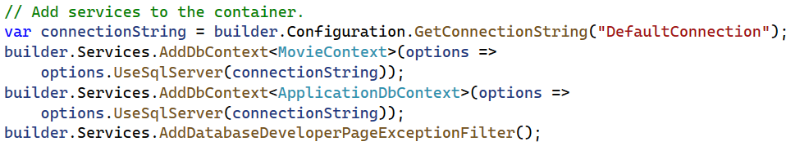
Program.cs
Register MovieContext as a service

Slide 15
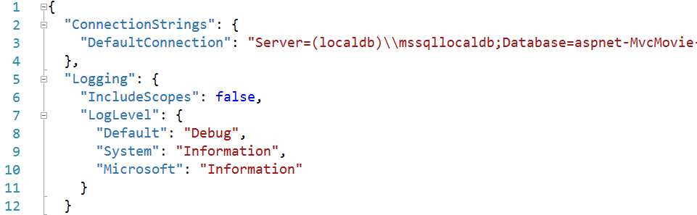
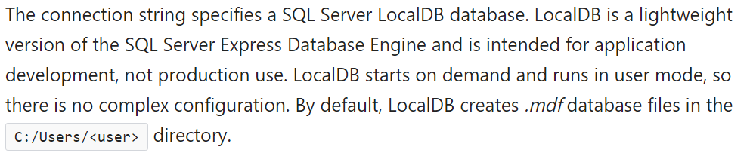
appsettings.json

Slide 16
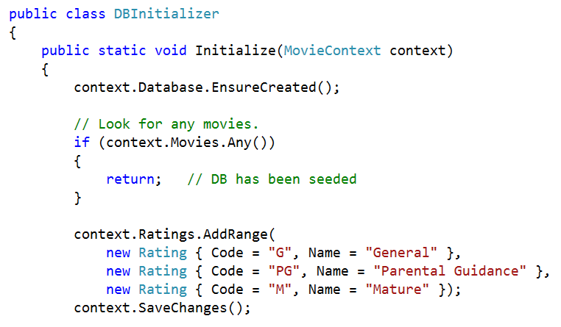
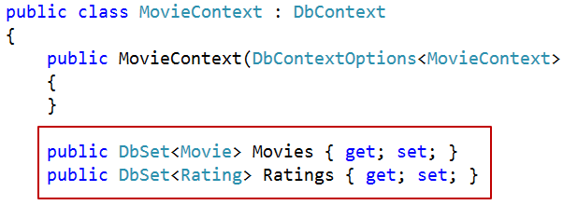
Test Data (resources)
Copy DbInitializer.cs to Data folder

Slide 17
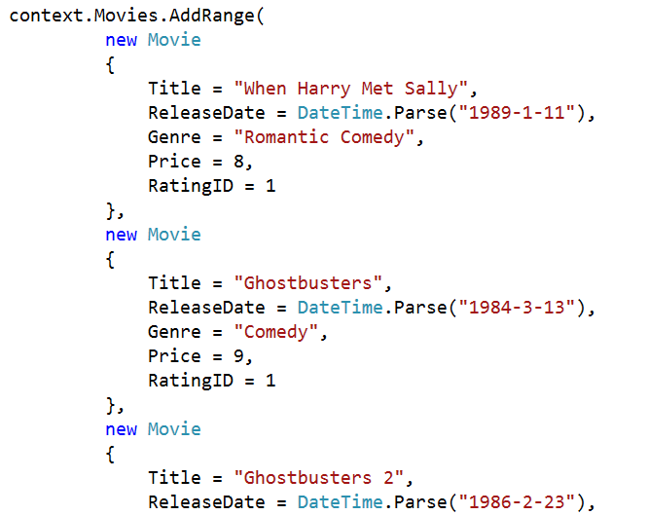
Test Data

Slide 18
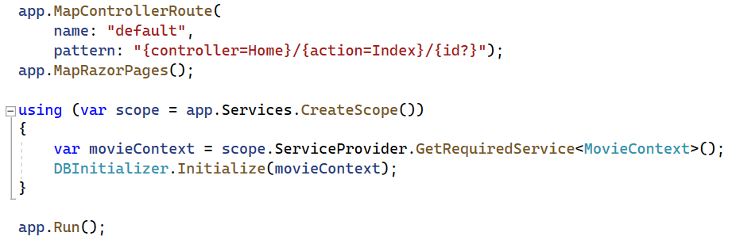
Program.cs
More on Dependency Injection later in this course

Slide 19
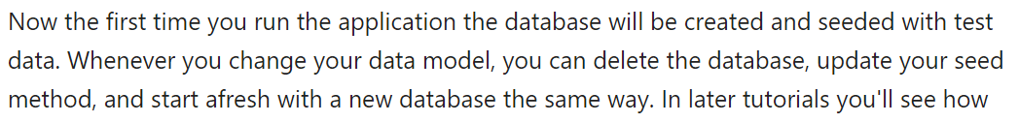
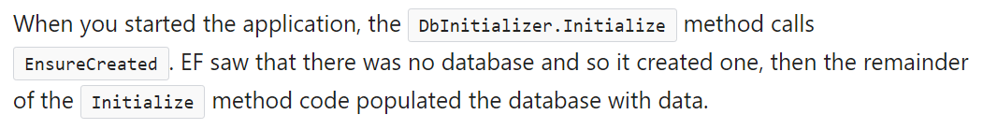
Run The Application

Slide 20
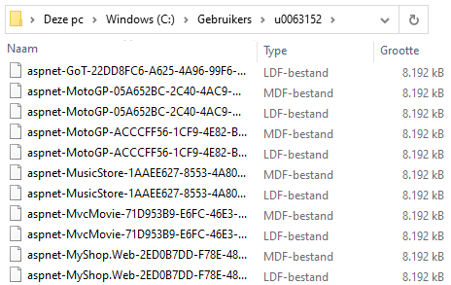
C:\users\xyz\aspnet-mvcmovie…mdf

Slide 21
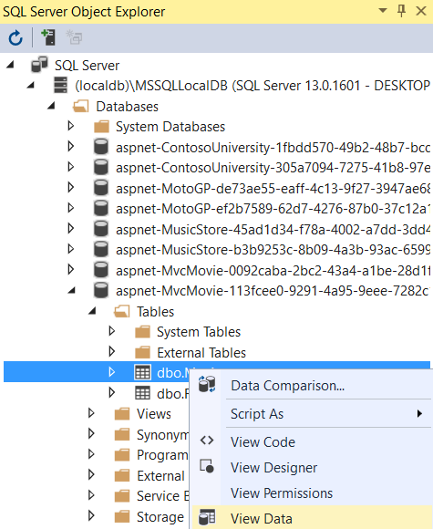
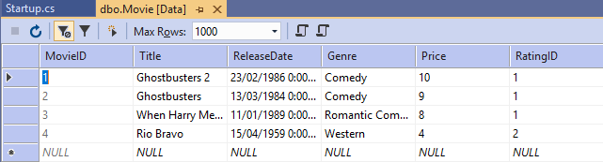
View | Sql Server Object Explorer

Slide 22
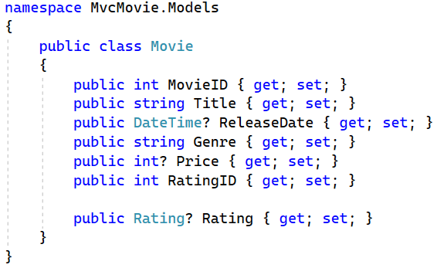
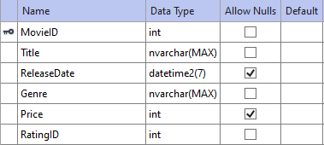
Sql Server Object Explorer
Movie | View Designer

Slide 23
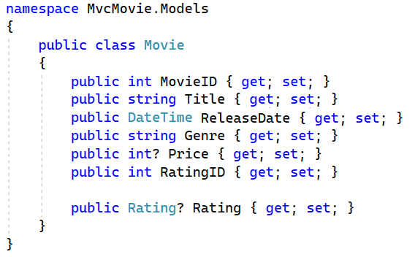
Required
ReleaseDate required

Slide 24
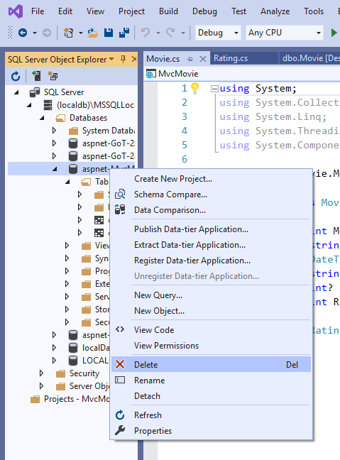
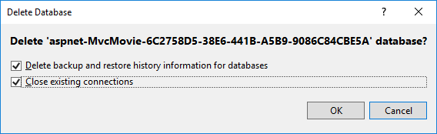
Delete the database
Better use Migrations (later in the course)

Slide 25

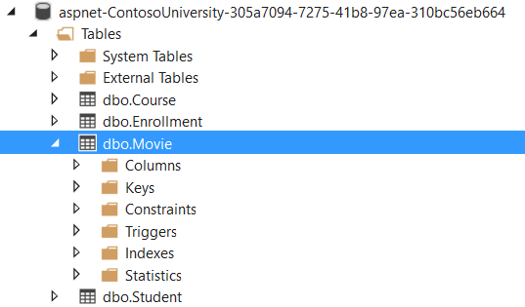
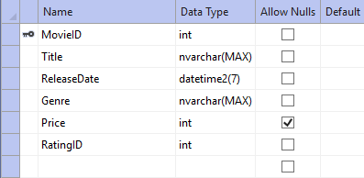
Run the Application

Slide 26
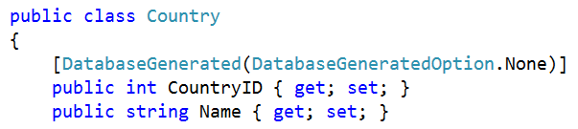
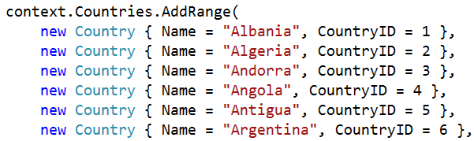
NO Auto Numbering (in Exercise)

Slide 27
Exercise
MotoGP Part 2

